Slide 1
Makerspace & Prototyping Lesson
Sarah Nagle
ENG 313
9/22/21
Creation & Innovation Services Librarian

Slide 2
What we’ll cover today
Makerspace Overview
Human-centered Design Basics
Game prototyping Activity
Discuss: Digital Fabrication

Slide 3
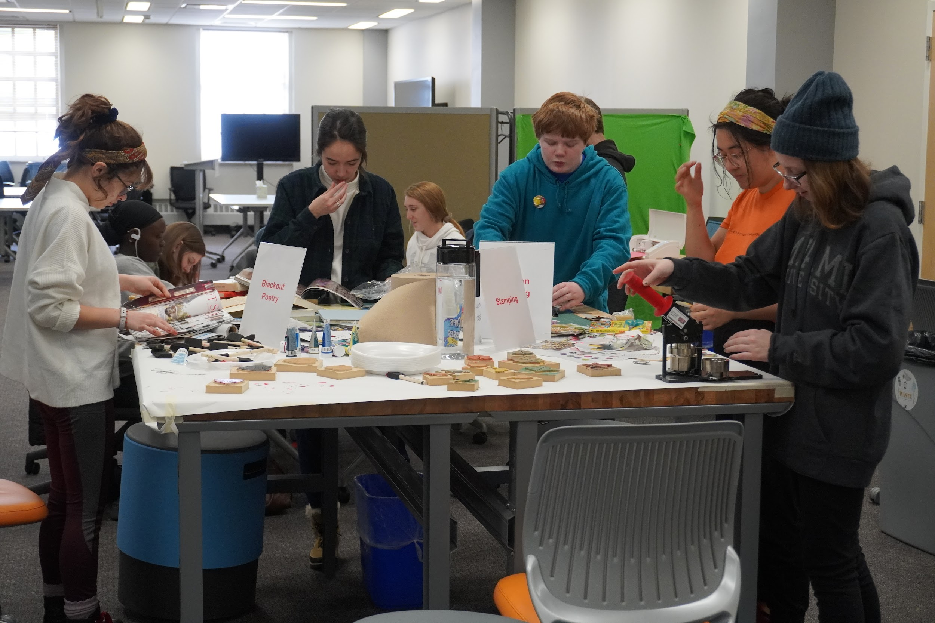
About the Makerspace
A hands-on, highly collaborative, and experiential learning space.
Equipment:
Glowforge Plus Laser Cutter
Lulzbot Mini 2 3D Printers
Carvey CNC Machines
Brother Sewing/Embroidery Machines
Heat Press
Silhouette Cameo 4 Craft Cutters
Sawgrass Sublimation Printer

Slide 4
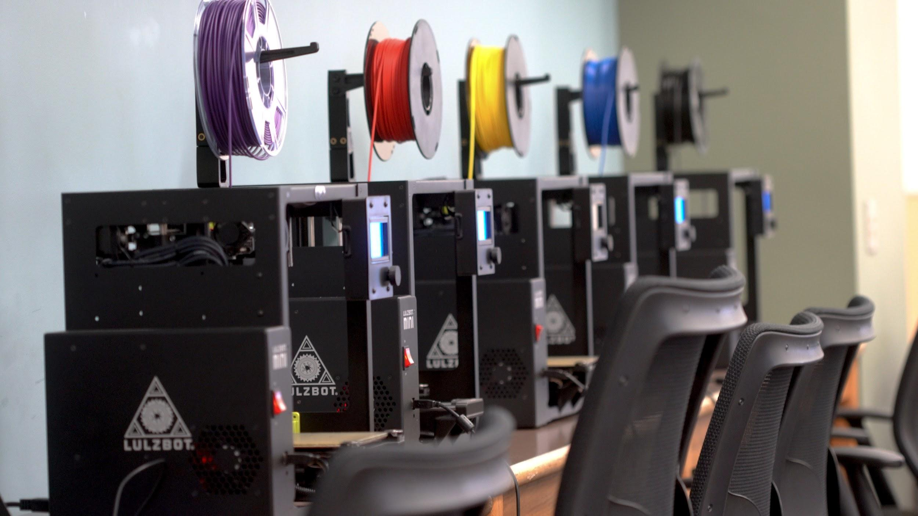
About the Makerspace
Appointment or walk-in use (bit.ly/makerspace-book)
It is FREE!
No previous maker experience required
Carvey machine & Glowforge - must do training w/ staff but we guide you through it
Self-directed work encouraged, but staff assistance is always available.
Academic projects are #1 goal, but personal projects are welcome too

Slide 5
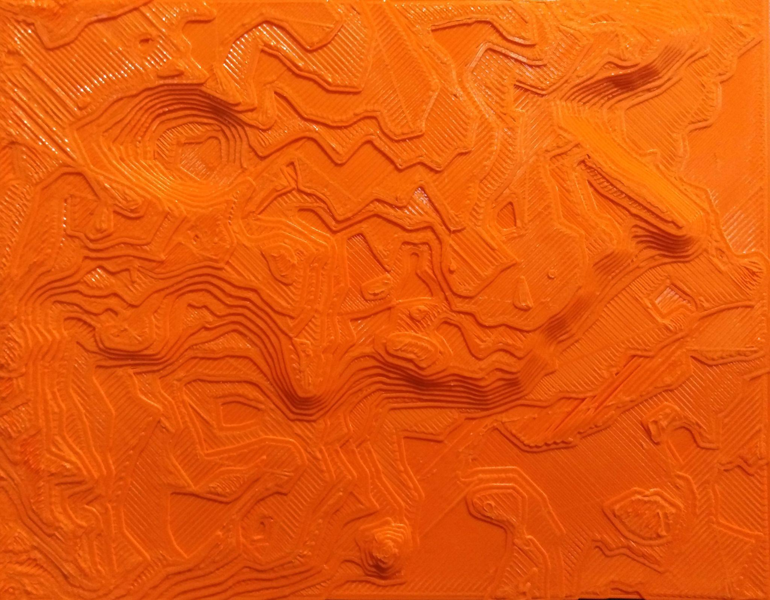
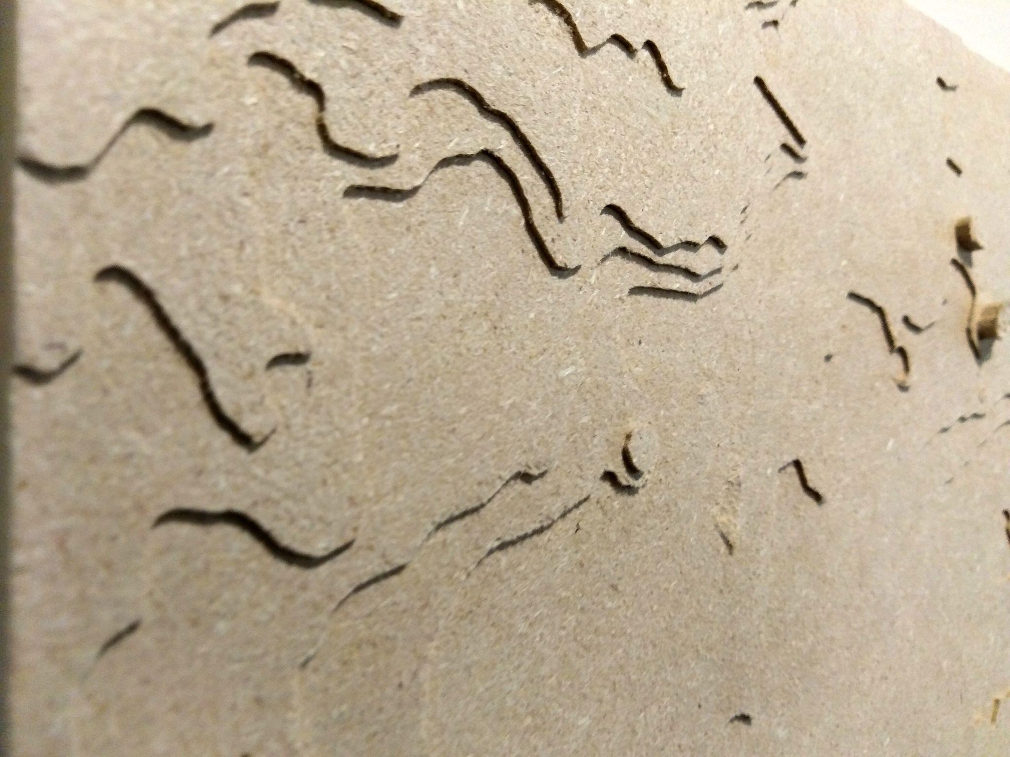
Why prototype with Makerespaces?
Prototyping used to be EXPENSIVE and SLOW
Makerspace tools allow for quick turnaround of multiple prototypes
Allows for more experimentation

Slide 6
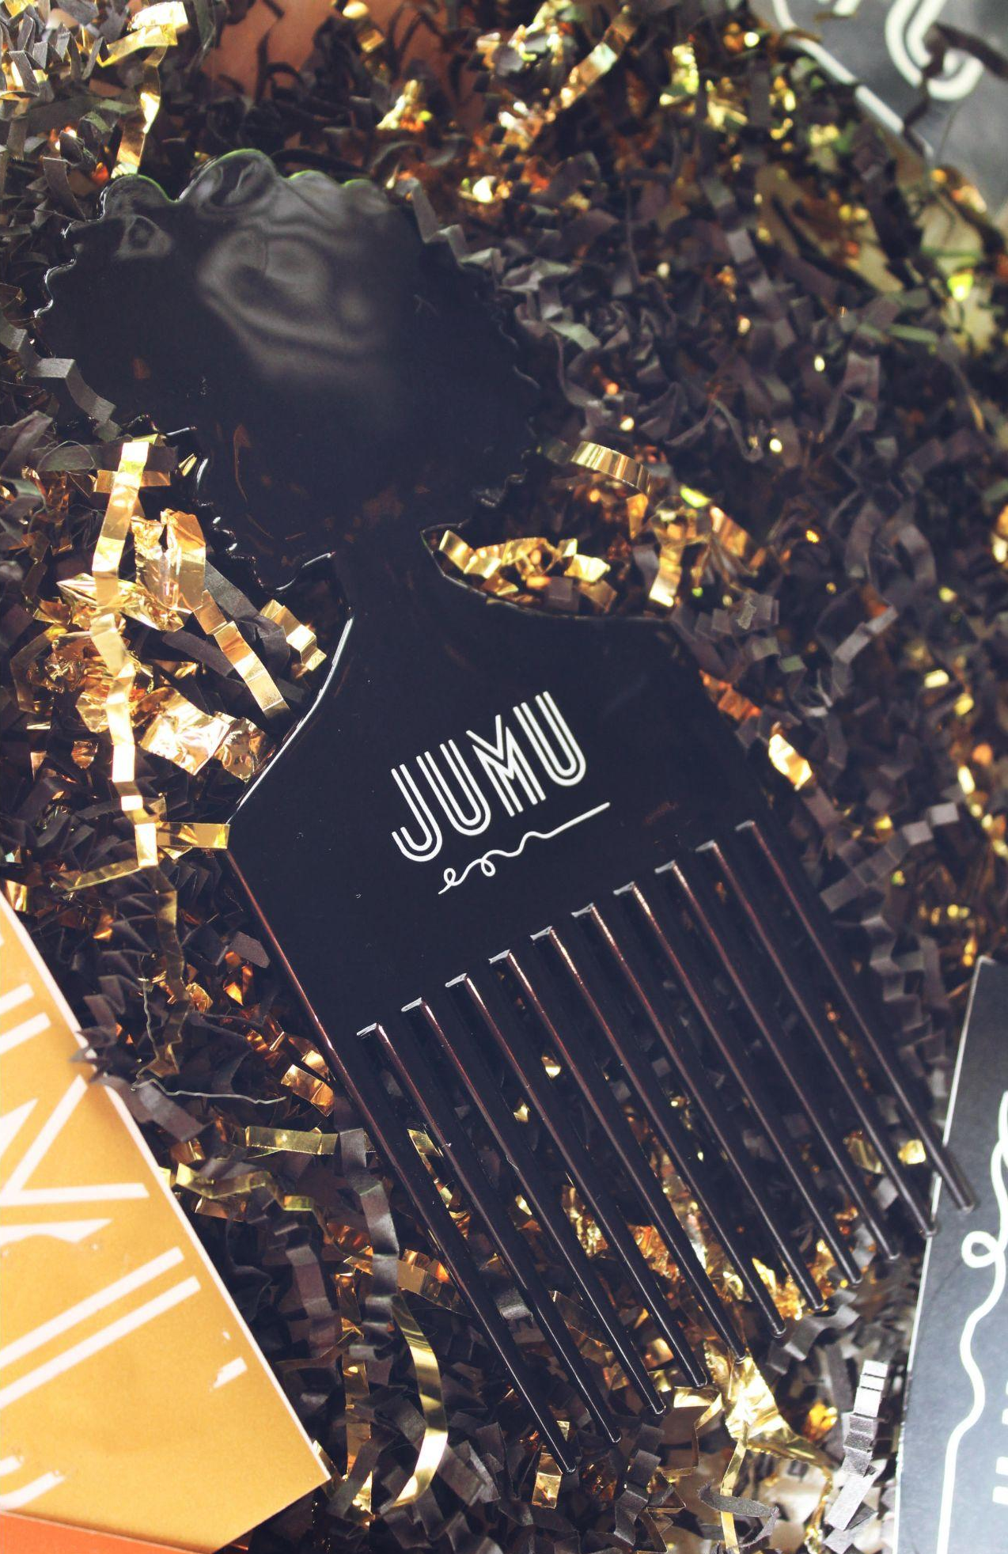
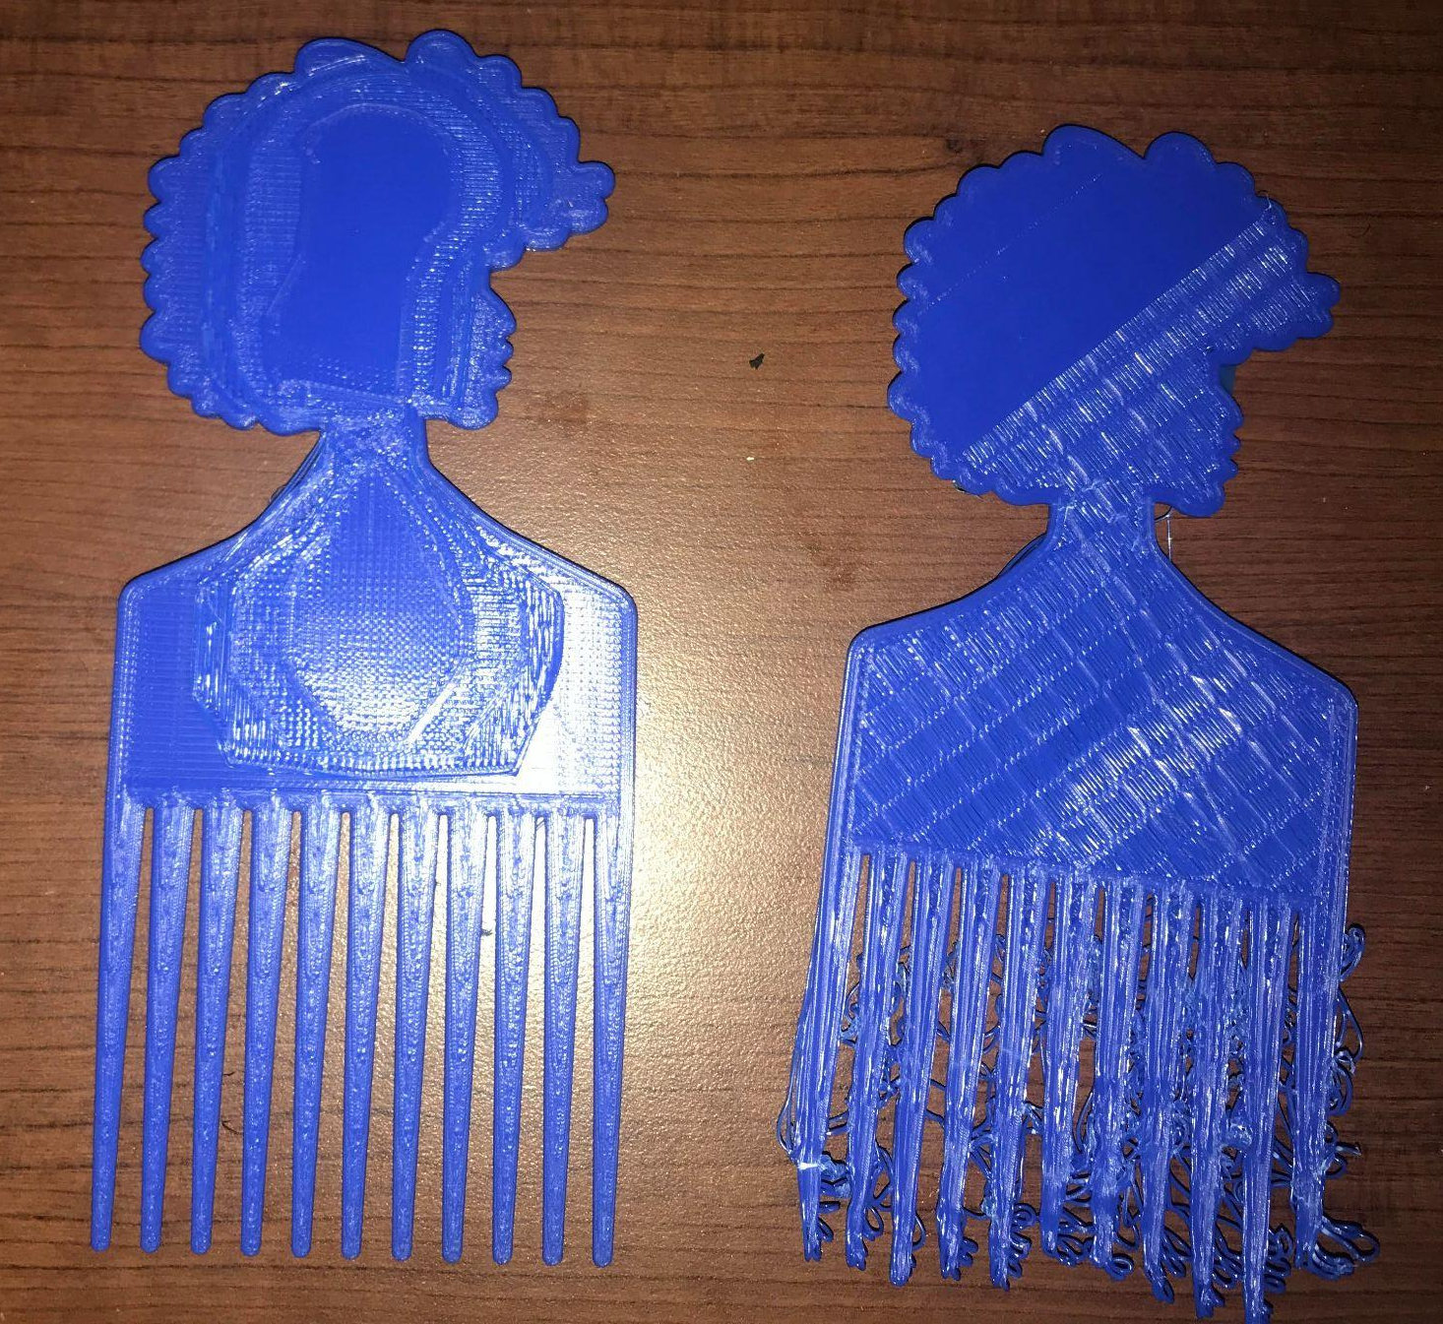
Prototyping with Makerspace Tools
3D Printing

Slide 7
Prototyping with Makerspace Tools
Laser Cutting
& Arduino

Slide 8
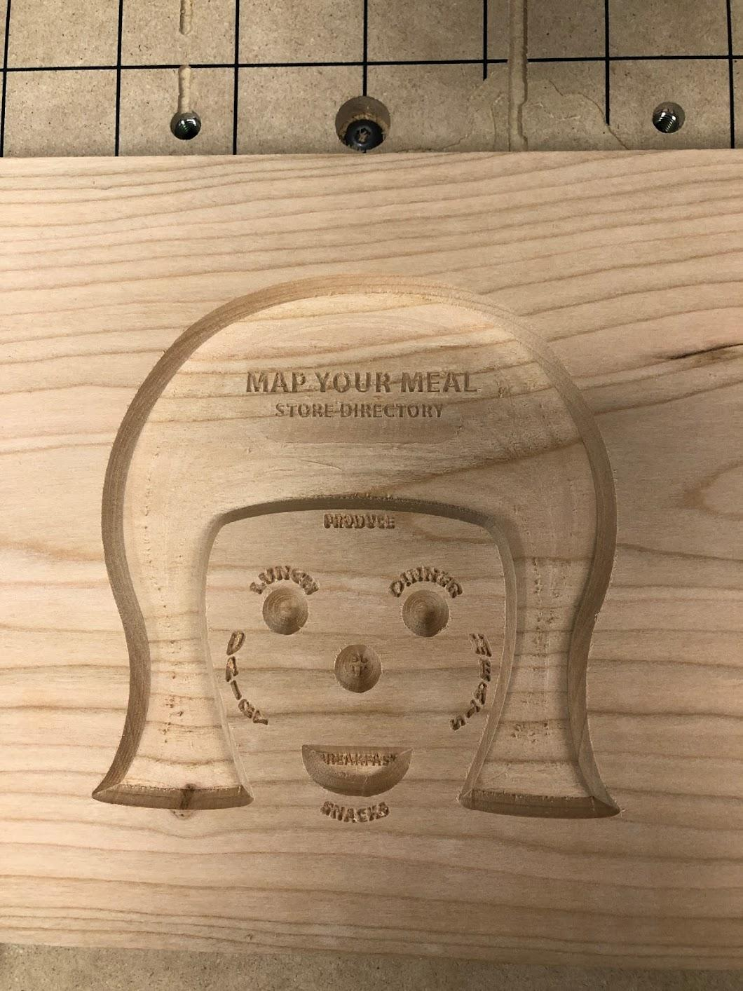
Prototyping with Makerspace Tools
CNC Machine

Slide 9
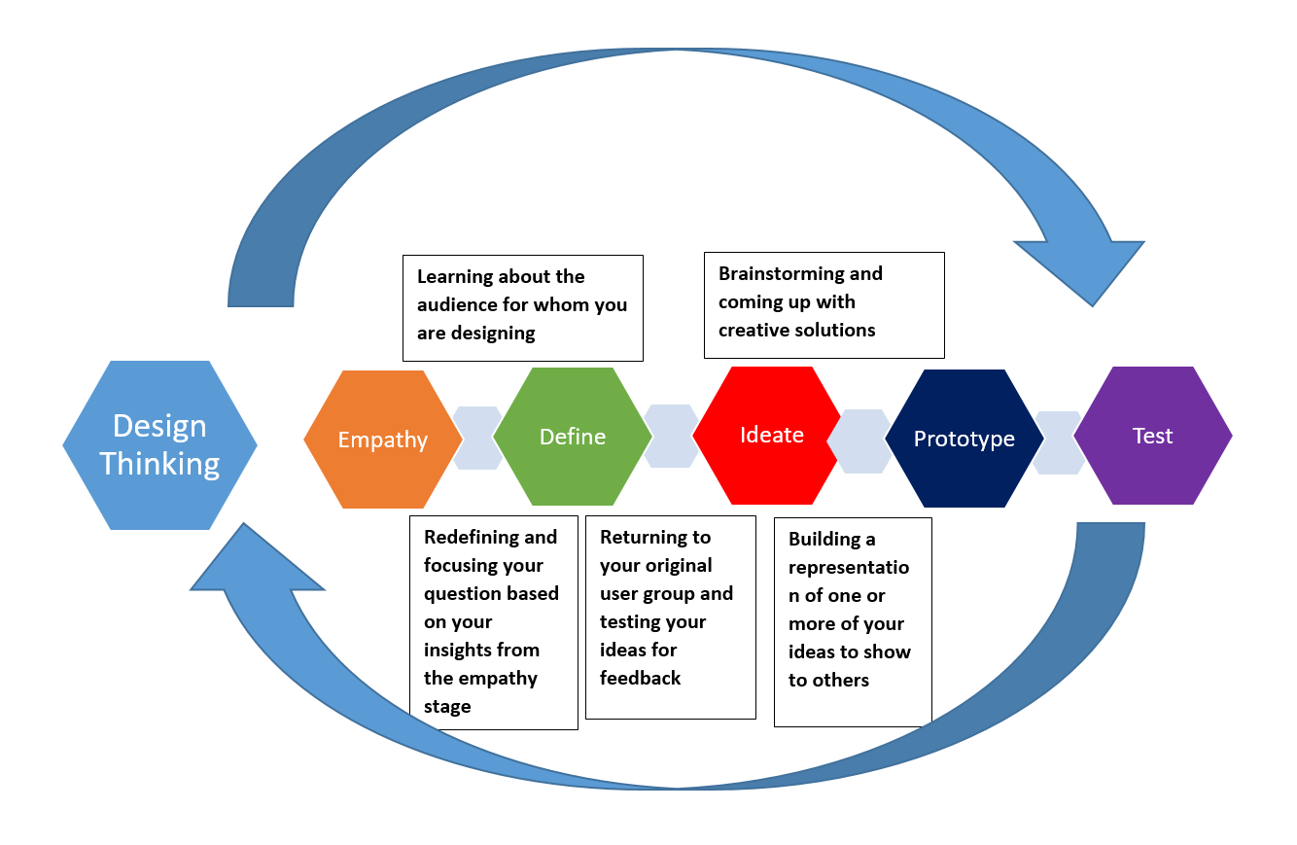
Design Thinking Process

Slide 10
Ideation
Some types of ideation
Quantity over quality
Divergent
thinking
Don’t hold back! Anything goes!
Brainstorming
Mash-up
Other people’s shoes
E-storm
Throwing out as many ideas as you can think of

Slide 11
30 Circles
Turn as many of the circles into a recognizable thing in 3 minutes

Slide 12
Now we Converge!
Discuss
Vote
Decide
Cluster

Slide 13
What is Prototyping?
Why Prototype?
Spur your thinking
Get feedback early
Avoid mistakes later
The stage in the human-centered design process where you start bringing ideas to life.
Prototype early and often!

Slide 14
Types of Prototyping
Physical
Digital
Environmental
Rough models of objects
Rough models of apps, websites, tools
People, processes, workflows

Slide 15
Prototyping Steps
Reflect
Build
Share
Repeat!

Slide 16
Game Ideation
3 minutes: individually, sketch a game. What are the parts you need?
3 minutes: share with your group, compare ideas, come to a common idea.
Goal: Create a game
(Examples: ring toss, table tennis,puzzle, etc.)

Slide 17
Game Prototype
Create a mockup of your game using the following supplies:
Paper
Popsicle sticks
Tape
Pipe cleaners
Time allowed: 10 minutes
Goal: Create a game

Slide 18
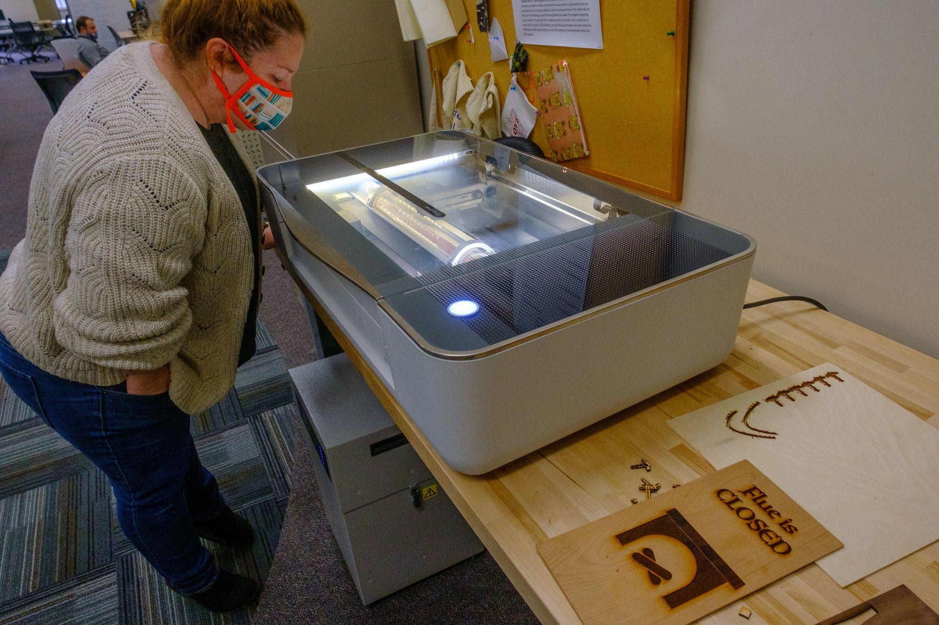
Discuss: Using the Makerspace for your Project
What Makerspace tools would you use for your ENG 313 prototype?
Why did you choose one machine/tool over another?
What changes would you make for the next prototype using Makerspace tools?
3D Printers
Laser Cutter
Rotary Cutters
Arduino/
Raspberry Pi
CNC Machines

Slide 19
Questions?
Email me!
pricesb@miamioh.edu
To book the makerspace:
lib.miamioh.edu/make
More info:
lib.miamioh.edu/makerspace
Some ideas and activities in this presentation courtesy IDEO U https://www.ideou.com/

